Slide 1
Medium-Sized Switched Network Construction
Securing the Expanded Network

Slide 2
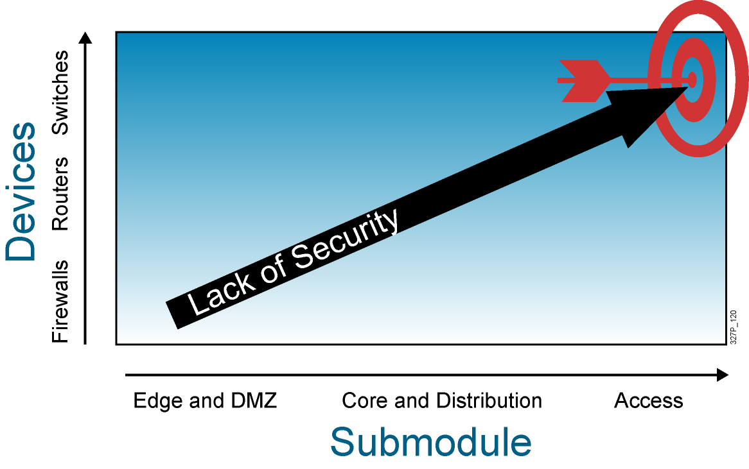
Overview of Switch Security

Slide 3
Recommended Practices:
New Switch Equipment
  Consider or establish organizational security policies.
  Secure switch devices:
    Secure switch access.
    Secure switch protocols.
    Mitigate compromises through switches.

Slide 4
Recommended Practices:
Switch Security
  Secure switch access:
    Set system passwords.
    Secure physical access to the console.
    Secure access via Telnet.
    Use SSH when possible.
    Disable HTTP.
    Configure system warning banners.
    Disable unneeded services.
    Use syslog if available.

Slide 5
Recommended Practices:
Switch Security (Cont.)
  Secure switch protocols:
    Trim Cisco Discovery Protocol and use only as needed.
    Secure spanning tree.
  Mitigate compromises through a switch:
    Take precautions for trunk links.
    Minimize physical port access.
    Establish standard access-port configuration for both unused and used ports.

Slide 6
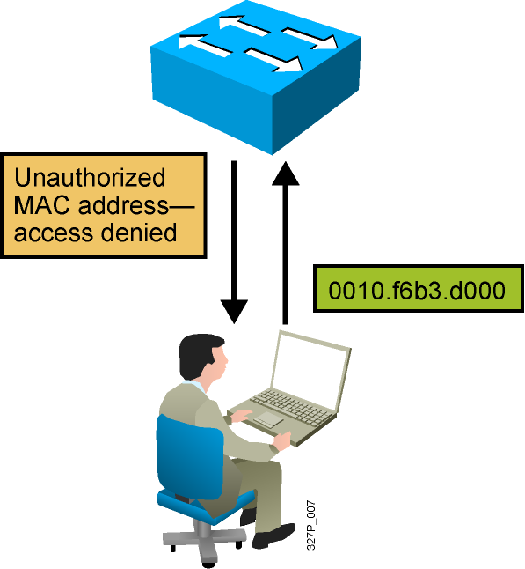
Port Security
Port security restricts port access by MAC address.

Slide 7
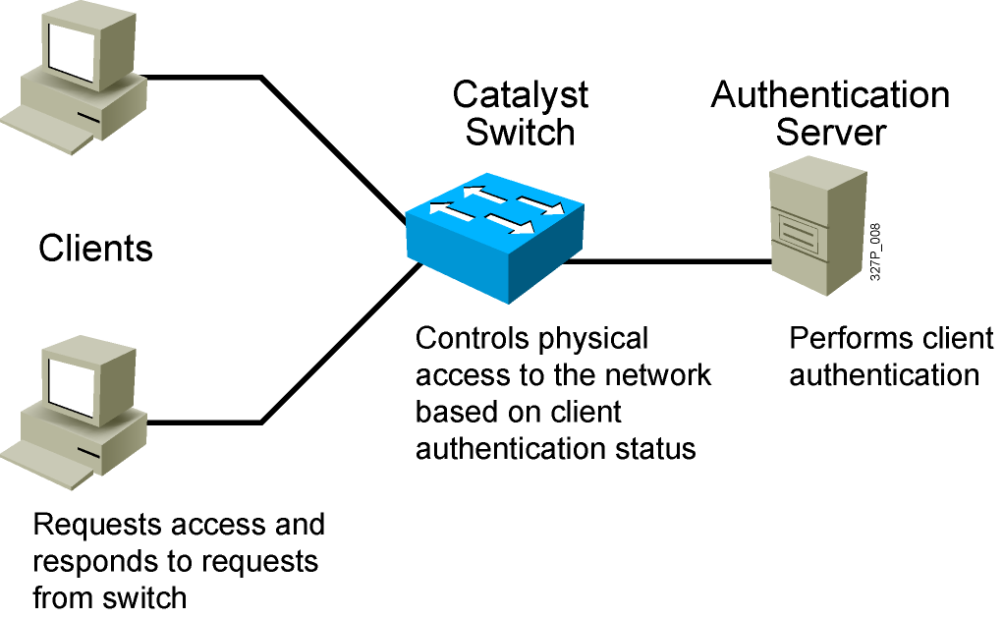
802.1X Port-Based Authentication
Network access through the switch requires authentication.
Notes:
Lesson Aim
<Enter lesson aim here.>

Slide 8
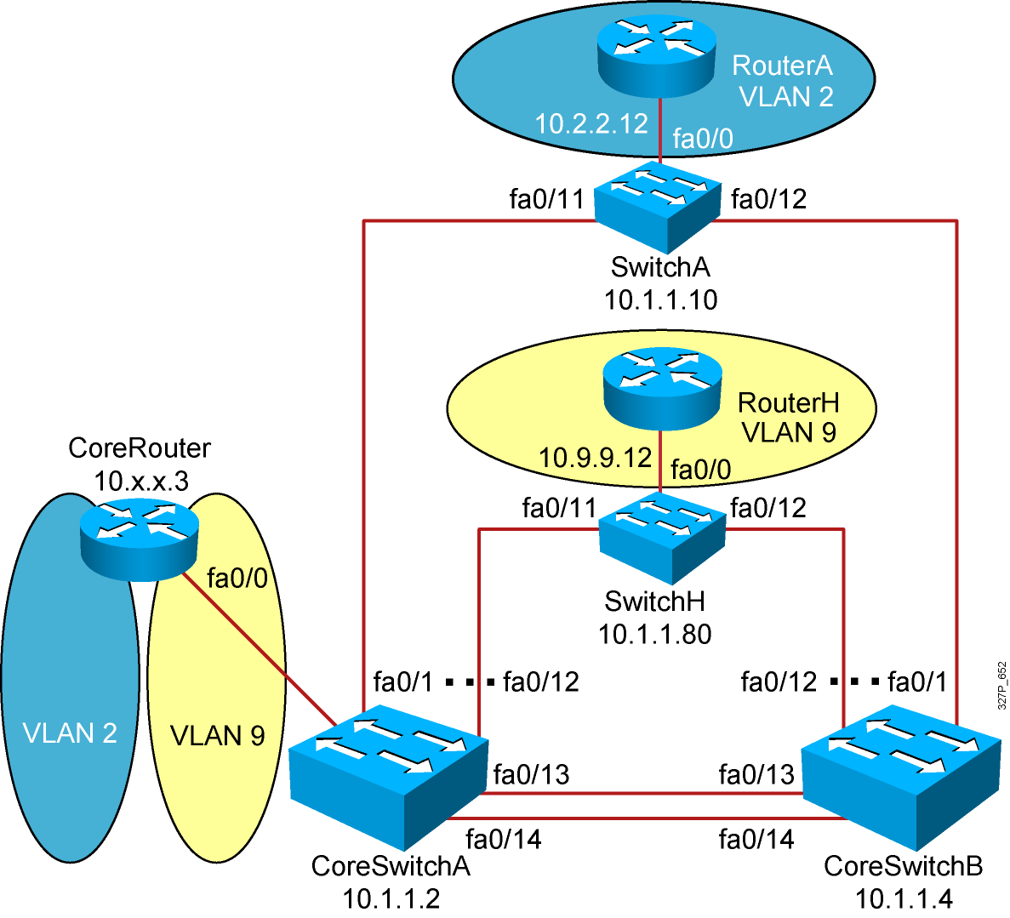
Visual Objective 2-1: Configuring Expanded Switched Networks
Subnet VLAN Devices
10.1.1.0 1 Core Switches, CoreRouter, SwitchX
10.2.2.0 2 CoreRouter, RouterA
10.3.3.0 3 CoreRouter, RouterB
10.4.4.0 4 CoreRouter, RouterC
10.5.5.0 5 CoreRouter, RouterD
10.6.6.0 6 CoreRouter, RouterE
10.7.7.0 7 CoreRouter, RouterF
10.8.8.0 8 CoreRouter, RouterG
10.9.9.0 9 CoreRouter, RouterH

Slide 9
Summary
  Follow recommended practices for securing your switched topology by using passwords, deactivating unused ports, configuring authentication, and using port security.
  To secure a switch device, you must secure access to the switch and the protocols that the switch uses.

